Slide 1
Car Insurance Policy Report
By Oyindamola Tomoye

Slide 2

Executive Summary
According to getinsurance.ng, car insurance policy covers the expenses for damages caused to your car due to accidents, or even theft.
This presentation aims to show how vehicle insurance claims vary my customer demographics as well as how the average claim amount varies by car make and model
The dataset used for this analysis was obtained from onyx data and can be found here

Slide 3

Project Objectives
To understand the average vehicular insurance claim amount and how it varies by car make
To delineate the total frequency of car insurance claims and it variations by marital status and car model
To understand the customer demographics that can be expected for a typical vehicular insurance company
This Photo by Unknown Author is licensed under CC BY-SA

Slide 4
DATA SOURCE AND DICTIONARY
The data used for this project was found on Onyx data. The link to this data source can be found here.
The data is a CSV file of 37542 rows and 16 columns.
Each record represents a particular customer.

Slide 5
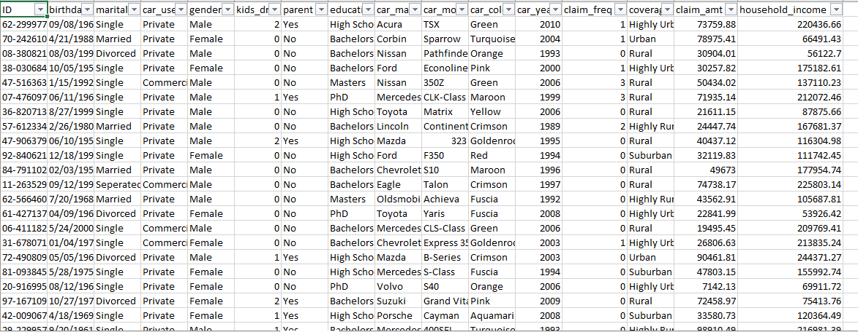
Unclean Data

Slide 6
CLEANING THE DATA (Power Query)
Since the data came in a CSV format, I had to first import the data using the data tab
I then converted the data into a table so that it’s easier to work with
I then imported it into Power Query to apply some transformations to it

Slide 7
CLEANING THE DATA (Power Query)
CLEANING STEPS APPLIED
The birthdate column was in the wrong format - mm/dd/yyyy instead of dd/mm/yyyy. This was corrected
A new column named "Age" which will contain the age of each customer.

Slide 8
CLEANING THE DATA (Power Query)
CLEANING STEPS APPLIED CONT’D
Upon closer inspection, it was observed that in "car_model" column, some of the car models were written in date formats.
These cars were made by the car manufacturer "Saab Automobile". Since there was no way to confirm the exact make, such erroneous date values were replaced with "N/A“
The query was then renamed as "Insurance" and loaded into Excel.

Slide 9
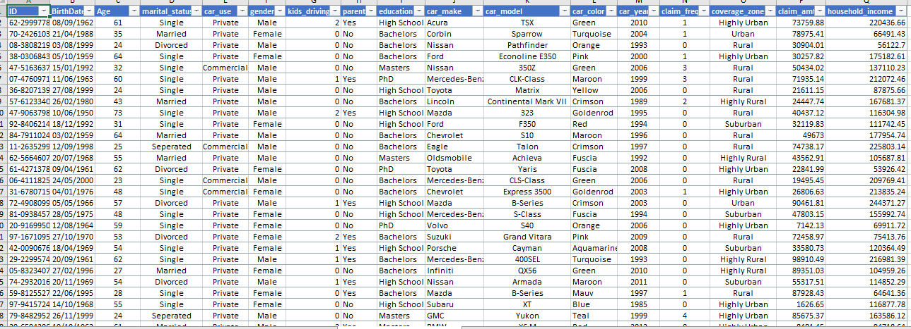
Cleaned Data

Slide 10
DATA ANALYSIS AND VISUALIZATION
The analysis steps were carried out in Excel using Pivot Tables and Pivot charts. The dashboard that was designed can be found and interacted with here.
This workbook consists of the following sheets:
The Home Page with some interactive buttons for navigation.
The Interactive Dashboard.
The Raw Data (named Raw Data).
The Transformed Data (named Insurance Policies - Data).
Other sheets containing the Pivot tables and pivot charts.

Slide 11

INSIGHTS
Equal proportion of males and females make car insurance claims.
More non-parents make car insurance claims compared to parents.
Single individuals make more insurance claims. Also, individuals with a bachelor's degree incur more car insurance claims.

Slide 12
INSIGHTS
The following cars models are associated with the most insurance claims on average:
Crossfire roadster
Truck Xtracrab
Dastsun/Nissan Z-car
Minx Magnificient
Virage

Slide 13
Recommendations
Insurance companies should ensure that single non-parents should be educated on driving safety and precautionary measures as part of the services they offer their customers (at no charge).
This will reduce the expenses they incur on paying claims out to such customer demographic. Also, manufacturers of car models associated with the most insurance claims and claim amounts should be investigated on the reasons for such higher frequencies and claim amounts. If it is discovered to be a manufacturer problem, the manufacturers should be made to pay heavier taxes for manufacturing more units of those cars.

Slide 14
Limitations of my Analysis
This analysis doesn't cover popular car insurance metrics such as average time to settle a claim, average revenue per policy holder, components of claim costs, customer retention rates e.t.c due to the limited data collected and the absence of fields to measure such metrics.
Also, the exact location the data was collected wasn't delineated in the data source. This means that the results of the analysis may not be translated to say data collectes from United Kingdom, Nigeria, Russia or any other country.

Slide 15
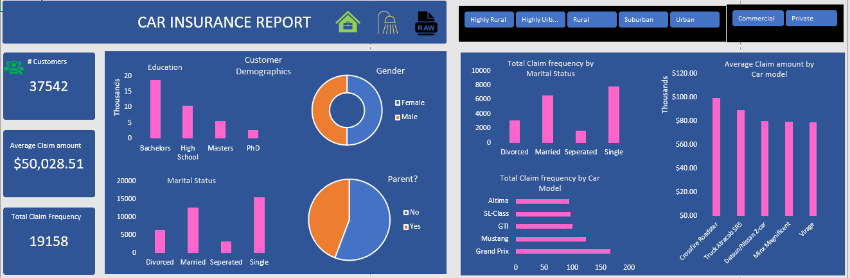
Final Dashboard

